Slide 1
Disaster management Module 3
Disaster risk management

Slide 2
Disaster risk management
The systematic process of using administrative directives, organisations, and operational skills and capacities to implement strategies, policies and improved coping capacities in order to lessen the adverse impacts of hazards and the possibility of disaster.

Slide 3
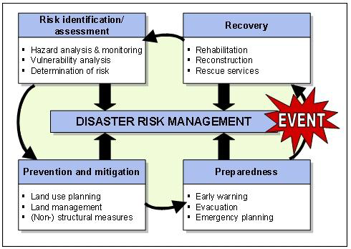
Disaster Risk Management Framework
The disaster risk management process (cycle)
comprises the following main elements:

Slide 4
Risk identification and assessment:
This involves determining and analysing the potential, origin, characteristics and behaviour of the hazard
E.g. frequency of occurrence/magnitude of consequences.

Slide 5
Application of risk reduction measures in mitigation:
Planning and implementation of structural interventions (e.g. dams, sea defence) or nonstructural measures such as disaster legislation.

Slide 6
Disaster preparedness and emergency management:
Activities and measures taken in advance to ensure effective response to the impact of a hazard, including measures related to timely and effective warnings as well as evacuation and emergency planning.

Slide 7
Recovery/Reconstruction:
Decisions and actions taken in the post-disaster phase
Having a view to restoring the living conditions of the affected population.

Slide 8
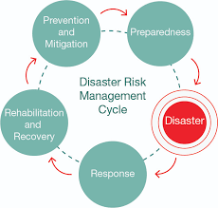

Slide 9
Disaster Risk Reduction (DRR)
The concept and practice of reducing disaster risks through systematic efforts to analyse and manage the causal factors of disasters, including
Through reduced exposure to hazards
Lessened vulnerability of people and property
Wise management of land and the environment
Improved preparedness for adverse events.

Slide 10
Given the importance of DRR in the international policy arena, five (5) priority areas are underscored in the Hyogo Framework for Action (2005-2015):
1. Governance
2. Risk identification, assessment, monitoring and early warning
3. Knowledge management and education
4. Reducing underlying risk factors
5. Preparedness for effective response and recovery

Slide 11
The Hyogo framework for action was succeeded by the Sendai Framework for Disaster Risk Reduction 2015-2030 at the Third United Nations World Conference on DRR which took place in March 2015 in Sendai, Japan.

Slide 12
The four (4) cornerstones of Disaster Risk reduction:
Four parallel and complementary lines of actions can be considered to reduce exposure to disasters and achieve a more sustainable approach to development:
1. Community / stakeholder participation
2. Public policy actions
3. Safer construction and urban development
4. Development of a culture of prevention

Slide 13
Disaster Prevention
Definition:
Disaster Prevention is defined as those activities taken to prevent a natural phenomenon or potential hazard from having harmful effects on either people or economic assets.
Broadly, disaster prevention refers to measures taken to eliminate the root causes that make people vulnerable to disaster.

Slide 14
The Basis of Disaster Prevention For disaster prevention to be successful, a priori planning is required.
Planning of prevention hinges on two (2) issues:
Hazard identification (identifying the actual threats facing a community)
Vulnerability assessment (evaluating the risk and capacity of a community to handle the consequences of the disaster).
Once these issues are put in order of priority, emergency managers can determine the appropriate prevention strategies.

Slide 15
Types of Disaster Prevention:
Disaster prevention may be considered as either primary or secondary.
Primary prevention is to reduce, or avoid the risk of the event occurring, by getting rid of the hazard or vulnerability,
e.g. to avoid overcrowding, deforestation, choked drainage and to provide services.
Secondary prevention means to recognise promptly the event and to reduce its effects,
e.g. by staying alert to possible displacements of population; by being ready to provide immunisation, food, clean water, sanitation and health care to the affected population.

Slide 16
Disaster Mitigation
Definition:
Disaster mitigation refers to the lessening or limitation of the adverse impacts of hazards and related disasters.

Slide 17
Primary Objectives:
The primary objectives of disaster mitigation are two (2) fold, namely
Hazard likelihood reduction
Risk consequence reduction.
Hazard likelihood reduction
This objective is only appropriate for a few natural hazards, as it is not possible to reduce the occurrence of many hazards. Eg: the likelihood of floods occurrence can be reduced by mitigation measures such as sea defence walls.

Slide 18
Risk consequence reduction
This is a reduction in the impact of a hazard, via a reduction in exposure and/or vulnerability.
It involves ensuring that the population, structures, or other systems are able to withstand such an event with as few negative consequences as possible.
Example: the construction of the erosion-resistant sea defence wall in Keta, Volta Region of Ghana.

Slide 19
So in reducing both hazard likelihood and risk consequence,
The primary aim is to decrease risk of death and injury to the population.
The secondary aims are to decrease damage and economic losses inflicted on public sector infrastructure and to reduce private sector losses.

Slide 20
Types of Disaster Mitigation Measures:
Broadly, disaster mitigation measures can be categorised into two:
Structural Mitigation Measures:
This refers to any physical construction to reduce or avoid possible impacts of hazards, which includes engineering measures and construction of hazard-resistant and protective structures and infrastructure.
Non-structural Mitigation Measures:
This refers to policies, awareness, knowledge development, public commitment, and methods and operating practices, including participatory mechanisms and the provision of information, which can reduce risk and related impacts.

Slide 21
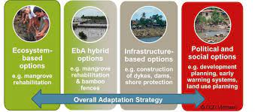

Slide 22
Disaster Preparedness
Definition:
Disaster preparedness encompasses the knowledge and capacities developed by governments, professional response and recovery organisations, communities and individuals to effectively anticipate, respond to, and recover from, the impacts of likely, imminent or current hazard events or conditions.

Slide 23
Components of a Comprehensive Disaster Preparedness Strategy includes:
Hazard, risk and vulnerability assessments
Response mechanisms and strategies
Preparedness plans
Coordination
Information management
Early warning systems
Resource mobilisation
Public education, training & rehearsals
Community-based disaster preparedness

Slide 24
Types of Disaster Preparedness:
Target-Oriented Preparedness:
Preparedness plans may be target specific, for instance, we may require different types of planning for the vulnerable groups of women, children, elderly and disabled.
Task-Oriented Preparedness: Specific groups jointly develop activities based on one of the community’s plans to evaluate the community’s capability to activate the preparedness plan in a real emergency. Eventually, these tasks enable the development of plan revisions, employee training and material resources to support readiness.
Disaster-Oriented Preparedness: This addresses the likelihood of occurrence of a specific disaster. Emphasis is placed on structural and non-structural mechanisms.

Slide 25
DISASTER RESPONSE AND RELIEF
Disaster responses are the set of activities taken during a disaster or immediate following a disaster, directed towards saving life and protecting property.

Slide 26
Factors that Determine the Nature of Disaster Response:
The type of disaster
The ability to take pre-impact actions
The severity and magnitude of disaster
The capability of sustained operations
Identification of likely response requirements

Slide 27
Requirement for Effective Response
Information
Resources

Slide 28
Disaster response planning
Roles and responsibilities are defined, policies and procedures are developed and generic tools for responses are identified and developed.

Slide 29
Types of disaster responses:
Search and rescue
First aid and emergency medical care
Evacuation
Evacuation centre management
Development of Standard Operation Procedure (SOPs)
Immediate repair of community facilities and services
Relief delivery
Coordination and Communication
Psycho-social counselling and stress debriefing
Medical services

Slide 30
Relief
It is defined as the provision of assistance or intervention during or immediately after a disaster to meet the life preservation and basic subsistence needs of those people affected.
Relief can be of an :
immediate,
shortterm,
protracted duration

Slide 31
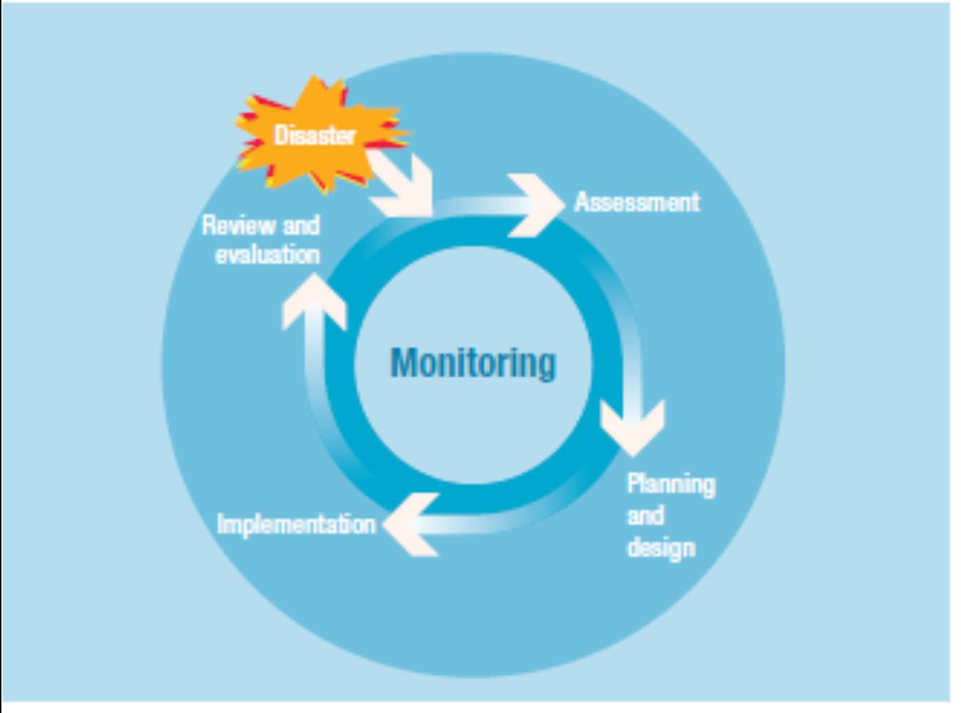
Project management cycle

Slide 32
The list of international relief response organisations is as follows:
Action Against Hunger (AAH),
CARE,
Caritas Internationalis,
Catholic ReliefServices, (CRS - USCC),
Emergency Nutrition Network (ENN),
Doctors Without Borders,
Food For The Hungry International (FHI),
Food For The Hungry,
Hunger
Plus, Inc., Interaction,
International Committee of the Red Cross (ICRC), International
Federation of Red Cross and Red Crescent Societies (IFRC), International Organisation
for Migration (IOM), International Rescue Committee (IRC), Lutheran World
Federation, Mennonite Central Committee (MCC), Mercy Corps (MC)
ETC…

